Slide 1
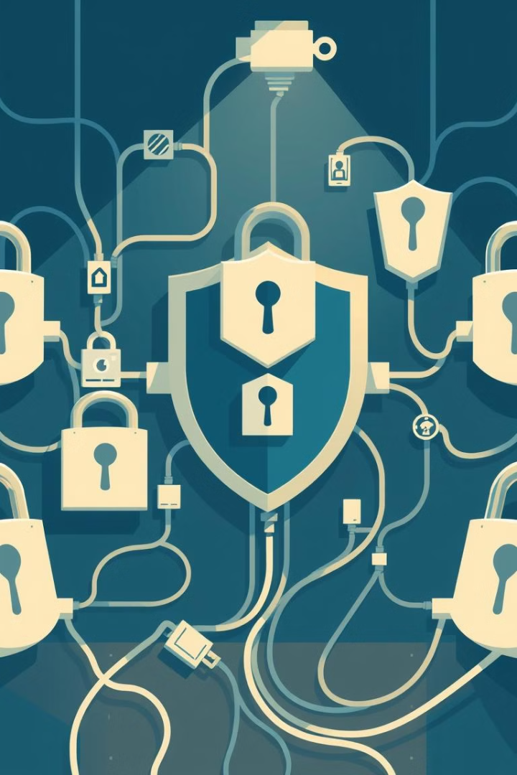
Risk Identification in Information Security

Slide 2
Introduction to Risk Identification
Definition
Objective
Detecting and documenting potential risks, threats, and vulnerabilities that could impact the security of information systems. It is the cornerstone of effective risk management.
Proactively address risks to prevent damage.
Support informed decision-making for security investments.
Comply with legal and regulatory requirements.
Scope:
Covers data, software, hardware, networks, and human factors.

Slide 3
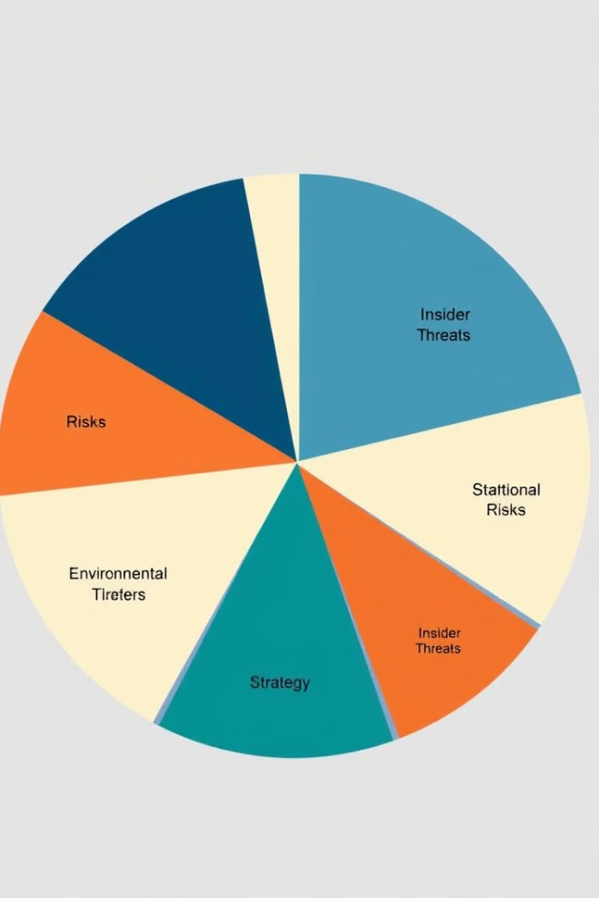
Importance of Risk Identification
Why It Matters:
Prevent data breaches and security incidents.
Avoid financial losses from attacks and system failures.
Protect brand reputation by maintaining trust.
Consequences of Neglecting Risks:
Increased exposure to threats like ransomware, insider threats, or phishing.
Operational disruptions and loss of sensitive data.
Legal fines and regulatory penalties.

Slide 4
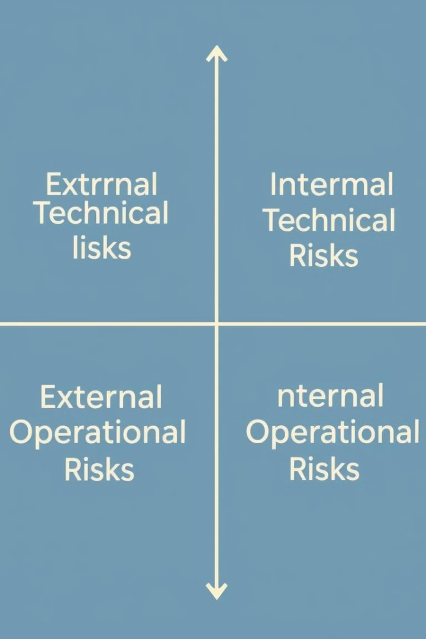
Types of Security Risks
External Risks
Internal Risks
Threats originating outside the organization, such as hacking, phishing, and malware.
Risks caused by employees, whether accidental or malicious. Examples include insider threats and human errors.
Operational Risks
Environmental Risks
Downtime caused by system failures, outdated software, or poor infrastructure.
Natural disasters like floods, earthquakes, or power outages impacting IT systems.

Slide 5





Steps in Risk Identification
Asset Identification
1
Document and classify critical assets.
Threat Analysis
2
Identify potential threats.
Vulnerability Assessment
3
Evaluate existing weaknesses.
Impact Analysis
4
Assess potential damage.
Prioritization
5
Rank risks based on severity.

Slide 6
Frameworks for Risk Identification
Aspect | ISO 27001 | NIST Cybersecurity Framework | OCTAVE
Purpose | Comprehensive security risk management. | Focuses on cybersecurity improvement. | Aligns risks with business objectives.
Adption | Globally recognized across industries. | Widely used in US critical sectors. | Popular in IT, finance, and defense.
Key focus | Information Security Management Systems (ISMS). | Identify, Protect, Respond, Recover. | Operational and organizational risks
Strength | Globally compliant, detailed framework | Flexible and adaptable. | Business-centric risk analysis.
Limitations | Resource-intensive to implement. | Requires customization for businesses. | Less emphasis on technical risks.

Slide 7
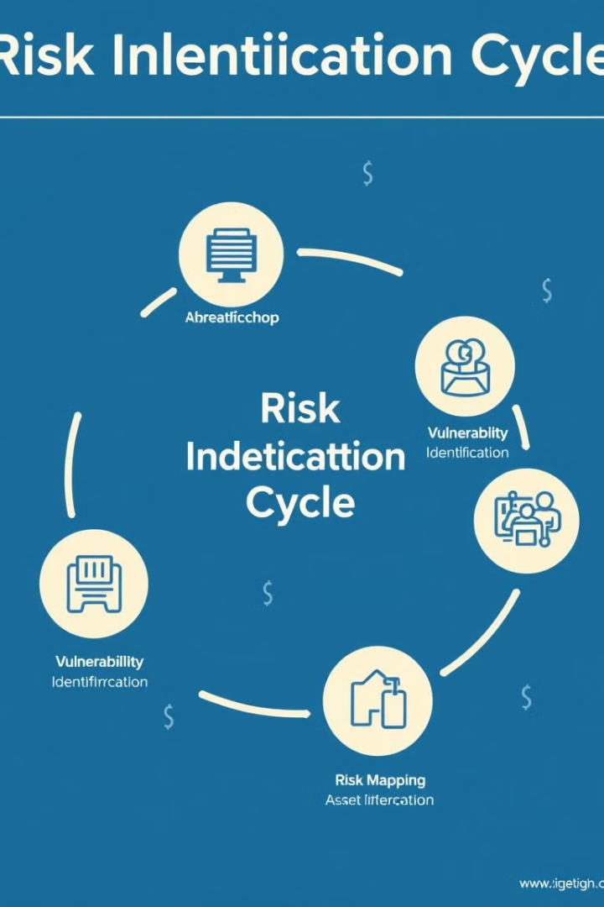
The Process of Risk Identification

Slide 8
Identifying Critical Assets
What are Assets?
Types of Assets
assets are the vital elements that contribute to the business operations and hold value for the organization. Protecting these assets is critical because if compromised, they can lead to major financial, reputational, and operational risks
Physical Assets:These include physical infrastructure and devices like servers, networking equipment, computers, data centers, and other hardware.
Digital Assets: Includes software applications, databases, intellectual property, proprietary data, and business-critical information.
Human Assets: employees, contractors

Slide 9
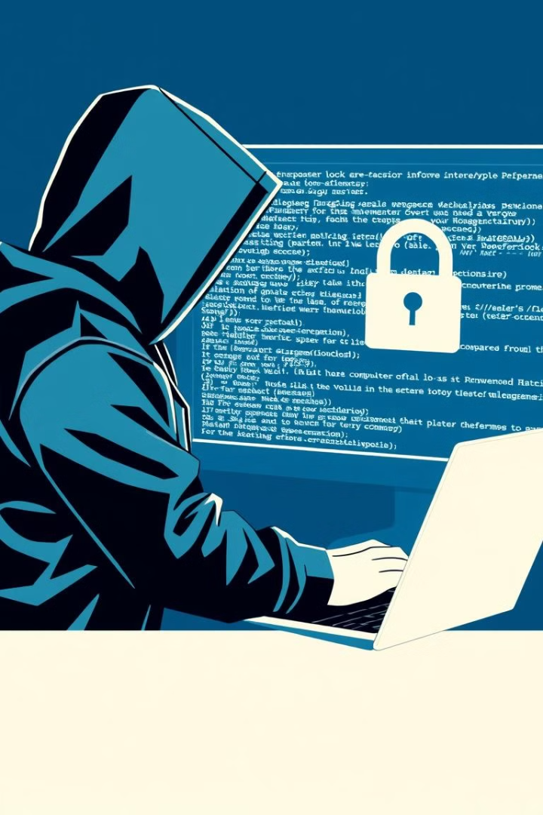



Identifying Threats
What are Threats?
Threats are any potential incidents or actions that could exploit vulnerabilities and cause harm to assets. Threats can originate from different sources and can be intentional or accidental.
External Threats
Internal Threats
Cyberattacks from hackers or nation-states
Malicious insiders or accidental threats
Environmental Threats
Floods, earthquakes, power outages

Slide 10
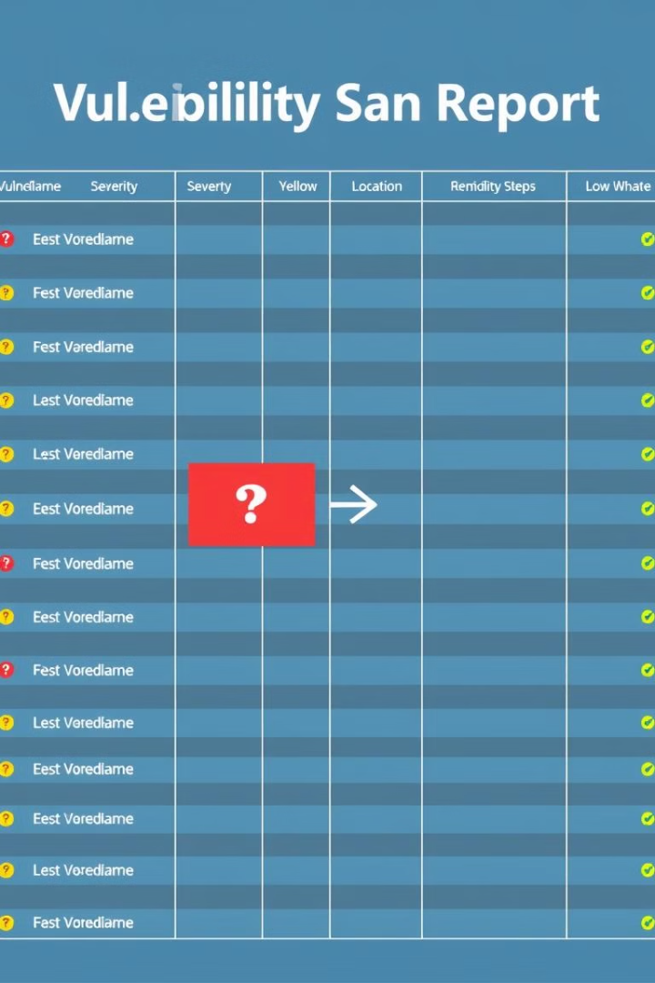
Identifying Vulnerabilities
Vulnerabilities are weaknesses in systems that may allow threats to gain access to or cause damage to critical assets. Identifying vulnerabilities is essential to reduce the attack surface and minimize potential damage.
Outdated Software
Weak Passwords
Systems that are not regularly updated may have known exploits
Easy to guess or improperly stored passwords
Lack of Training
Employees susceptible to phishing scams

Slide 11



Mapping Threats to Vulnerabilities
List Identified Threats:Identify and list all potential threats, both internal (e.g., employee mistakes) and external (e.g., cyberattacks).
1
Match Threats to Vulnerabilities:Link each threat to relevant system vulnerabilities, such as linking phishing threats to a lack of employee training.
2
Assess Likelihood & Impact:Evaluate the likelihood and potential impact of each risk, prioritizing the most critical ones for action.
3

